Slide 1


Pulse+
Satya Yoganand Addala
ID:2086008
Class: hci 440

Slide 2
Description
Assignments – Currently it helps to review the grades and scores and notify about due dates
Although this integrated experience provides us to launch course homepage option my application will provide a single time login for all the courses and provides with an interface of all the available options which are present in D2L
Common use cases involve notifying a user on the due date and the other is notifying the user when grades get updated.
This integrated experience available called ”Pulse”. But pulse+ application will improve upon or extend the experience like helps user to complete some small assignments like quiz’s and provides to participate in discussion posts.

Slide 3
Description
Users can get benefited by using this app as they don’t have to login to D2L each time for completing small quizzes and reading the discussion posts.
In Pulse , we don’t see this option as it has been used only to check Grades. Although it provides a web-based usage and Pulse + will provide a handy application with familiar Ui Experience as well.
It helps students to interact with one another using discussion boards.

Slide 4
Affordances
Cognitive affordance – Enable user to think, learn, understand and know about the things
1) Listing all the courses that are ongoing and also which have already been done.
2) Displaying the ongoing discussions in the discussion forums.
2) Grades button which helps in displaying the grades in the grades selection.
3) Able to provide a pin option for the course to prioritize
4) Listing all the notifications when the notifications button is clicked

Slide 5
Affordances
Sensory affordance – Enable user in sensing
1) Allowing the users to check the status of the updated grades.
2) Able to view the number of people that have replied to the posted discussion.
3) Able to view the number of people that have watched to the posted discussion.
4) Later on, you can view the deadlines and questions on Discussion forms.

Slide 6
Affordances
Physical affordance – Enable user to do something physically
1) Selecting a Course is a physical Affordance.
2) Selecting the Discussion Board option
3) To participate in a discussion click on the discussions button to view all the discussions.
4) Replying/Starting a new discussion by typing.
5) Attempting a quiz.
6) Able to check view the calendar by clicking calendar option.
7) To view the calendar press the Calendar button.
8) To view the notifications click on the notifications button

Slide 7
Affordances
Functional affordance – Enable user to use tools
1) Allowing to choose between the courses.
2) Posting the content written in a discussion.
3) Allowing to complete the quiz.
4) Allowing to view grades and due dates
5) Providing a notifications and calendar option to do the course work in time.
6) Providing a subscriptions option to view all the subscribed content.
7) Providing an option to download the course content.

Slide 8
Users
User 1 : Student Login
Goal for the User1 :
Students should be easily able to learn /interact with other students easily via discussion forums.
Students can easily access the course details much more easier than accessing the current webpage via laptop/computer.
Since there is an inbuilt notification on due dates the user can easily check the upcoming events and he can complete the task if he has less time or if he is in transit.

Slide 9
Users
User 2 : Tutor Login.
Goals for User 2 :
Tutors can easily interact with the Students by knowing them through the discussion forums.
He/She can easily identify the students who are good at using technology and the way the concept has been delivered.
Tutors will have their admin access to manage the due dates and can also update any assignments.
There will be an inbuilt notification for discussion forms to access directly from where ever they are.

Slide 10
User1: Scenario
Before application
Here is the student called Emma. She is a student at DePaul university to complete her Master’s Degree in Computer Science. She had spent 6 months at the University .Due to covid situations she has to enroll for Online courses and the thing is she is not able to interact with any of her classmates.
Although she had a pulse Application she can only view the due dates of the quiz’s.

Slide 11
User1: Scenario
While using application
Then one of his friends suggests pulse+ Application to participate in discussion forums and to complete the quiz. Then Emma installed pulse+ application and with in no time she got familiar with the application and she starting to participate in the discussion forums and got to know her classmates and got to gain some knowledge it also helped her complete the Quiz and her grade has been updated. she felt happy with the application and finds it very useful.

Slide 12
User1: Scenario
After using application :
One day Emma meets her friend, Then she asks Emma about application. Then Emma with his happy face tells that. It is pretty and very helpful. Now she can easily interact with her other classmates and she can spend some time with her classmates when she is free.can complete the assignments in time no matter where she is. When ever she want, she can keep track of the due dates and submit her quizzes in time.
After using this application, she suggested her friends to use this app. Even they are happy that application.

Slide 13
User2: Scenario
Before using application :
Here is one of the Professors who teaches a course and this semester he doesn’t have any In-class students enrolled due to covid situation. Since it is an Online course the professor doesn’t have good interactions with his students and not able to estimate his student skills.
Although he had a pulse Application he can only view the discussion boards once in a while.

Slide 14
User2: Scenario
While using application :
Then the university launches my application and the professor uses to know that it provides a discussion board option and to notify when ever a students start a new thread and this way the students will get more interacted with their professor and the professor can also resolve all the students doubts in no time.He can also alter the due dates whenever he wanted.
After using this Application,the professor finds it more useful in the current situation.

Slide 15
User2: Scenario
After using application :
From then on the professor finds the application is easy to use and he will be available all the time for his students.
He also shares his experience with other tutors and encourage them to use them if they are facing the same situation as theirs.
.Even other tutors find it useful and they are happy with the application.

Slide 16

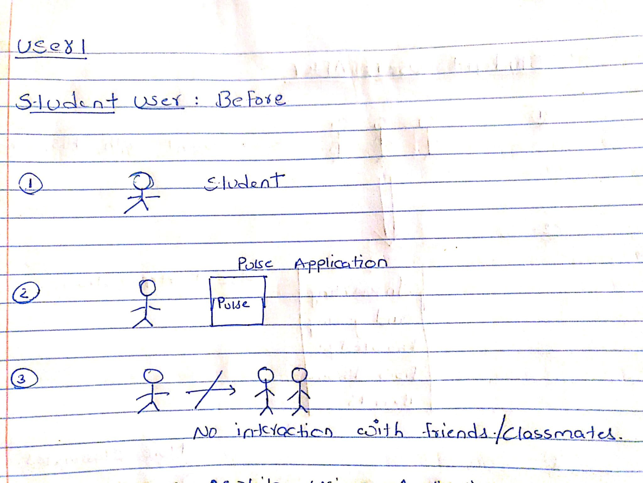



Student User: Sketches (Before)

Slide 17
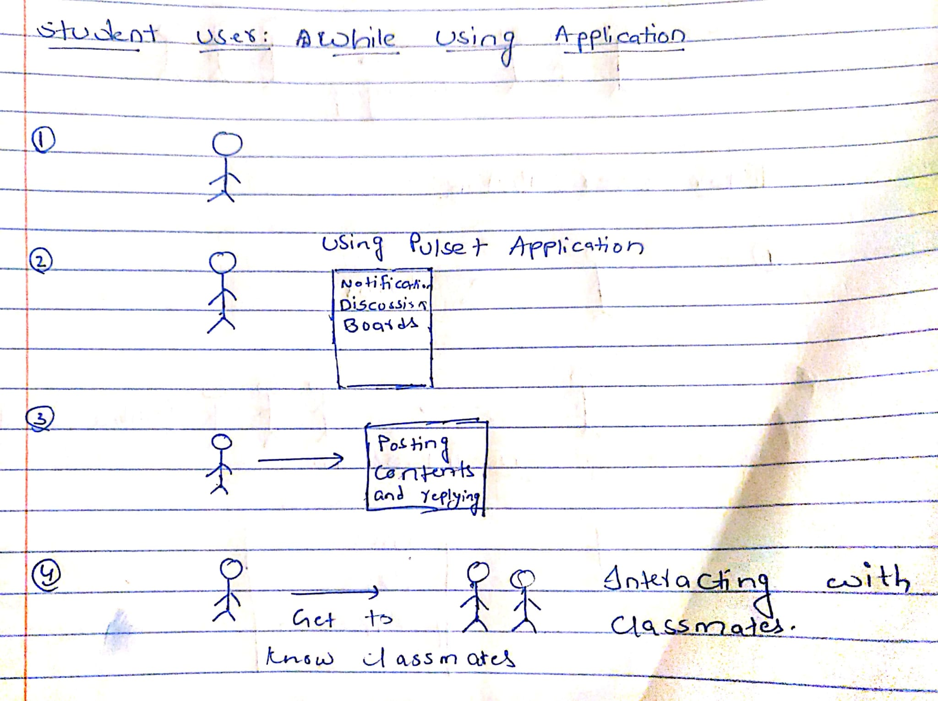
Student User: Sketches (While Using)

Slide 18
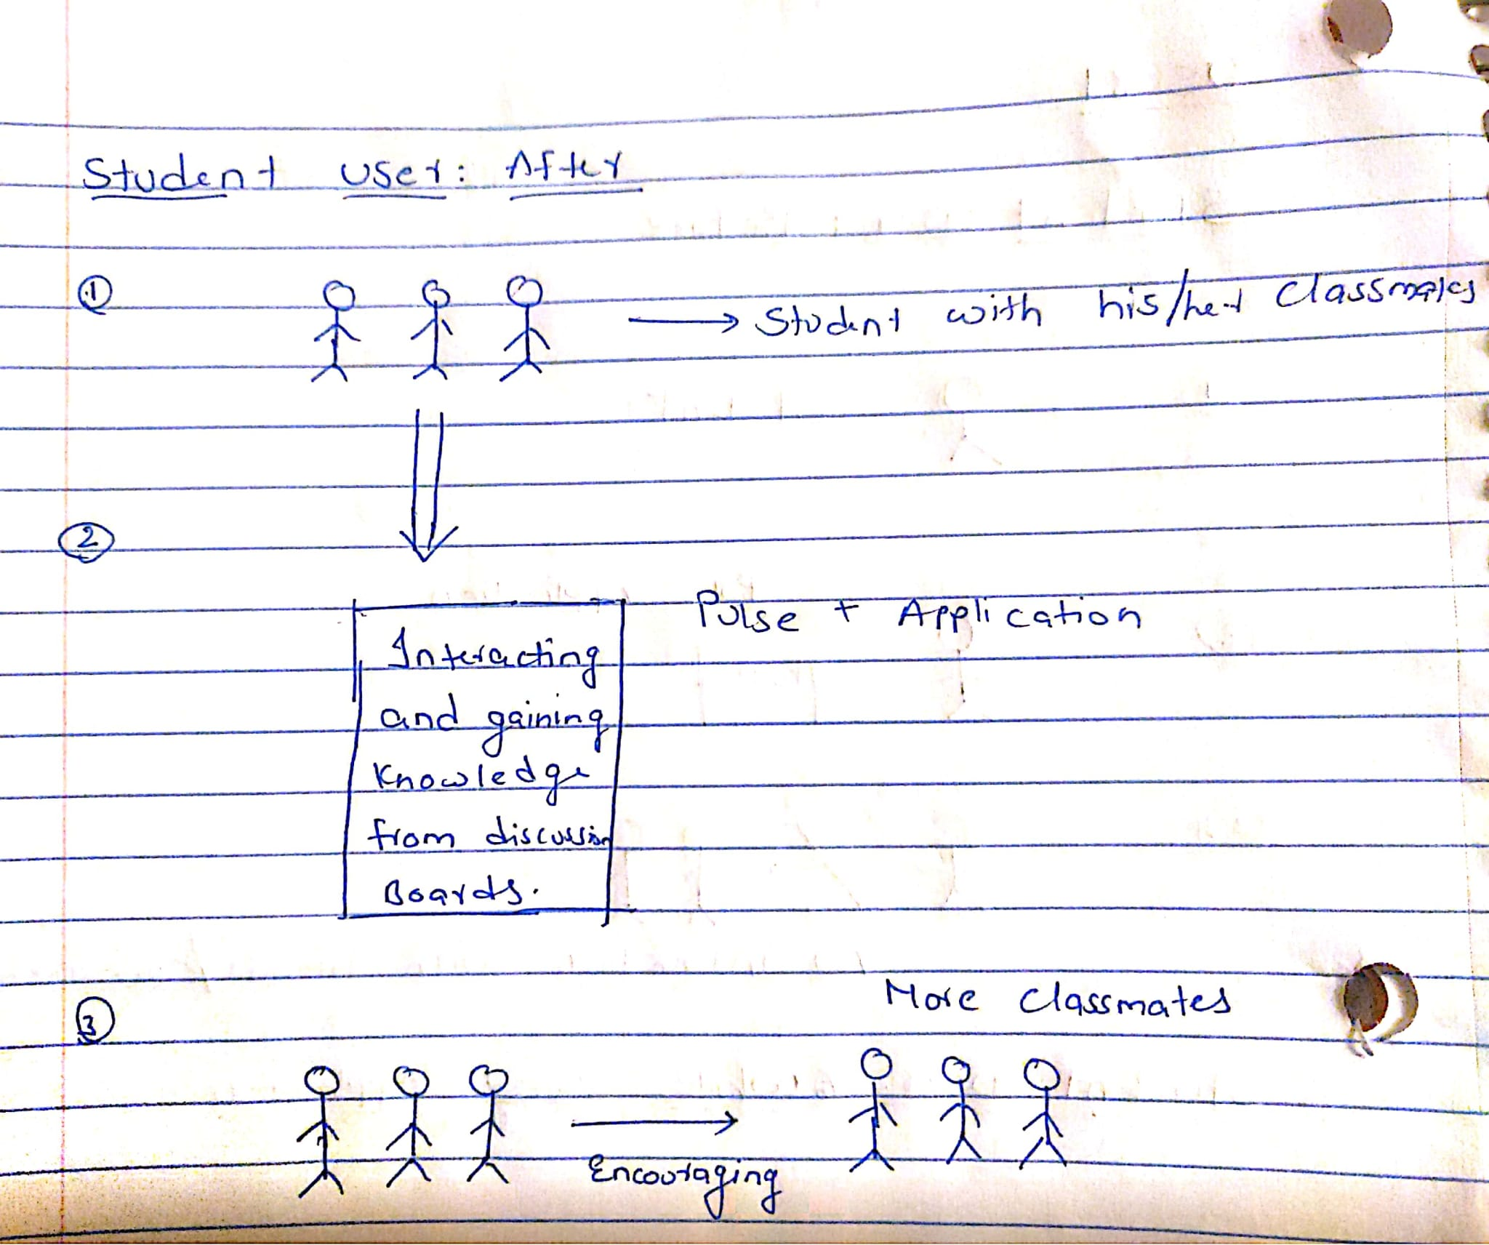
Student User: Sketches (After)

Slide 19
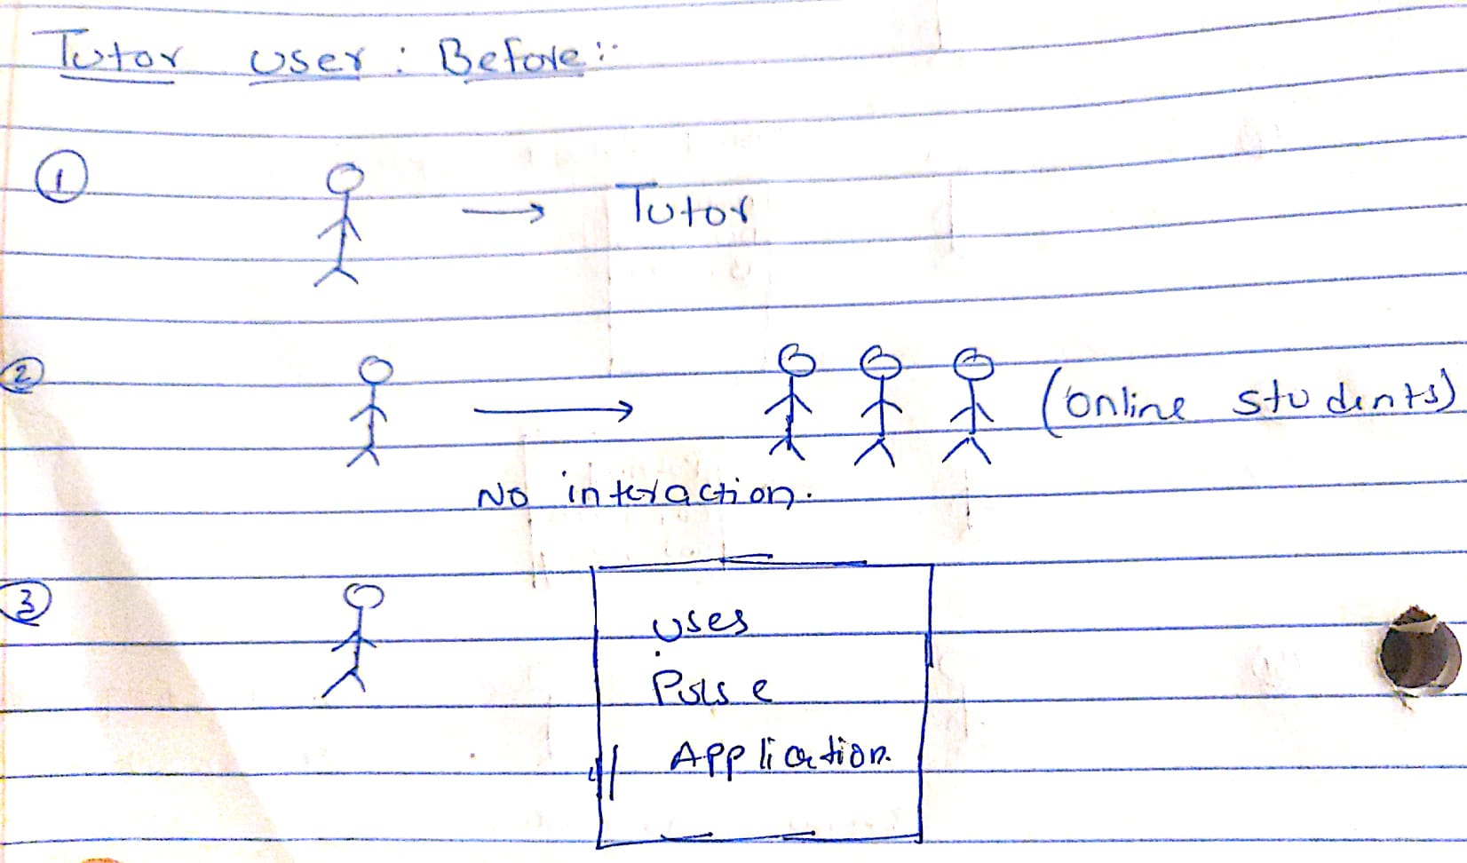
Tutor User: Sketches (Before)

Slide 20
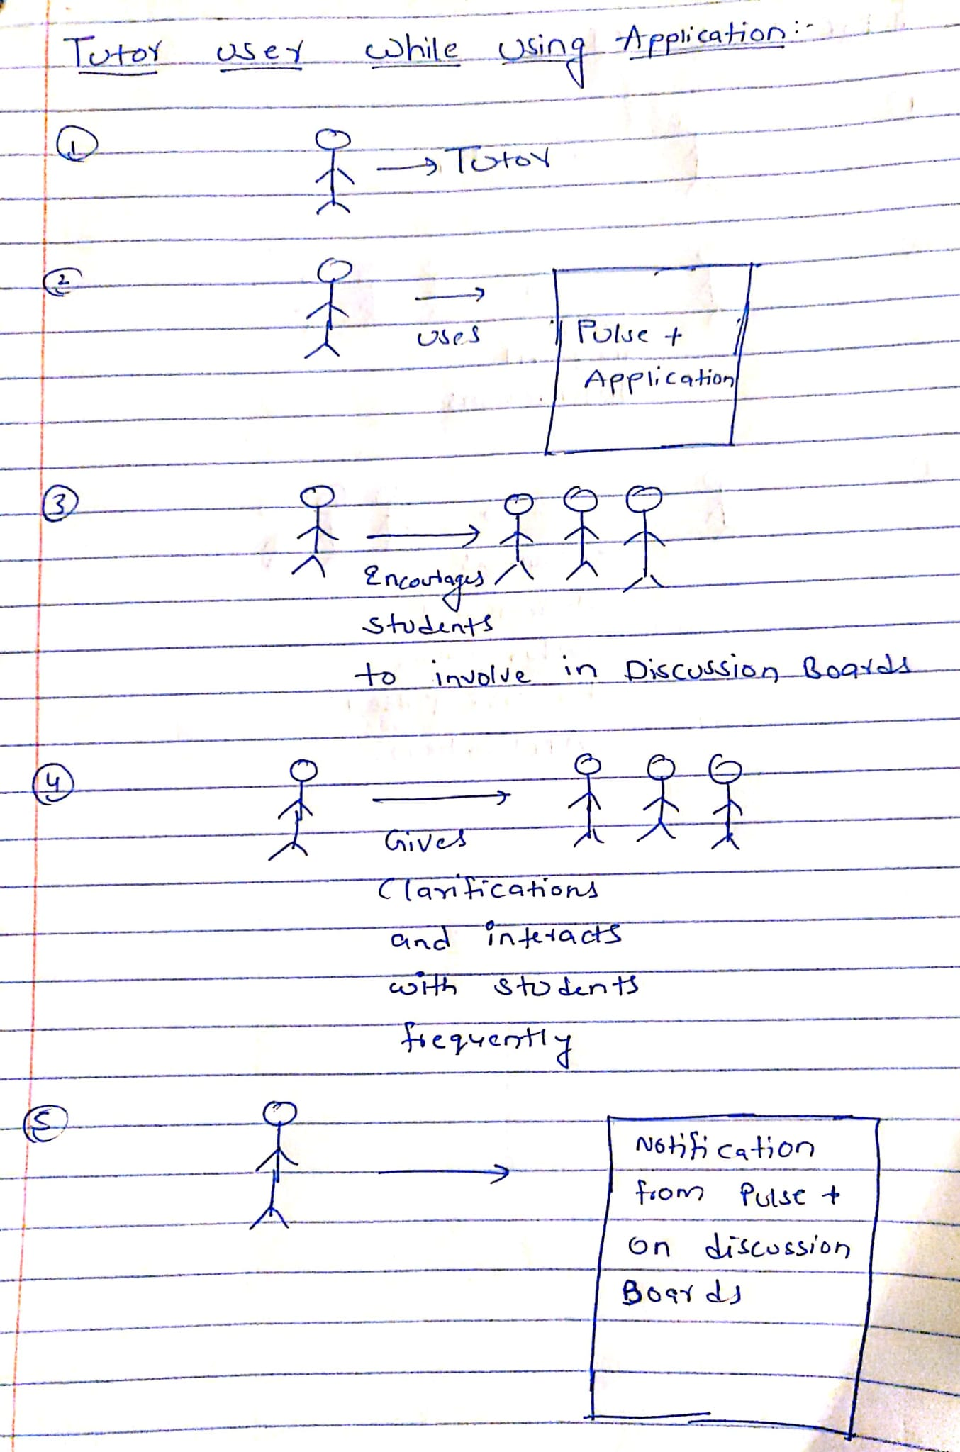
Tutor User: Sketches (While Using)

Slide 21
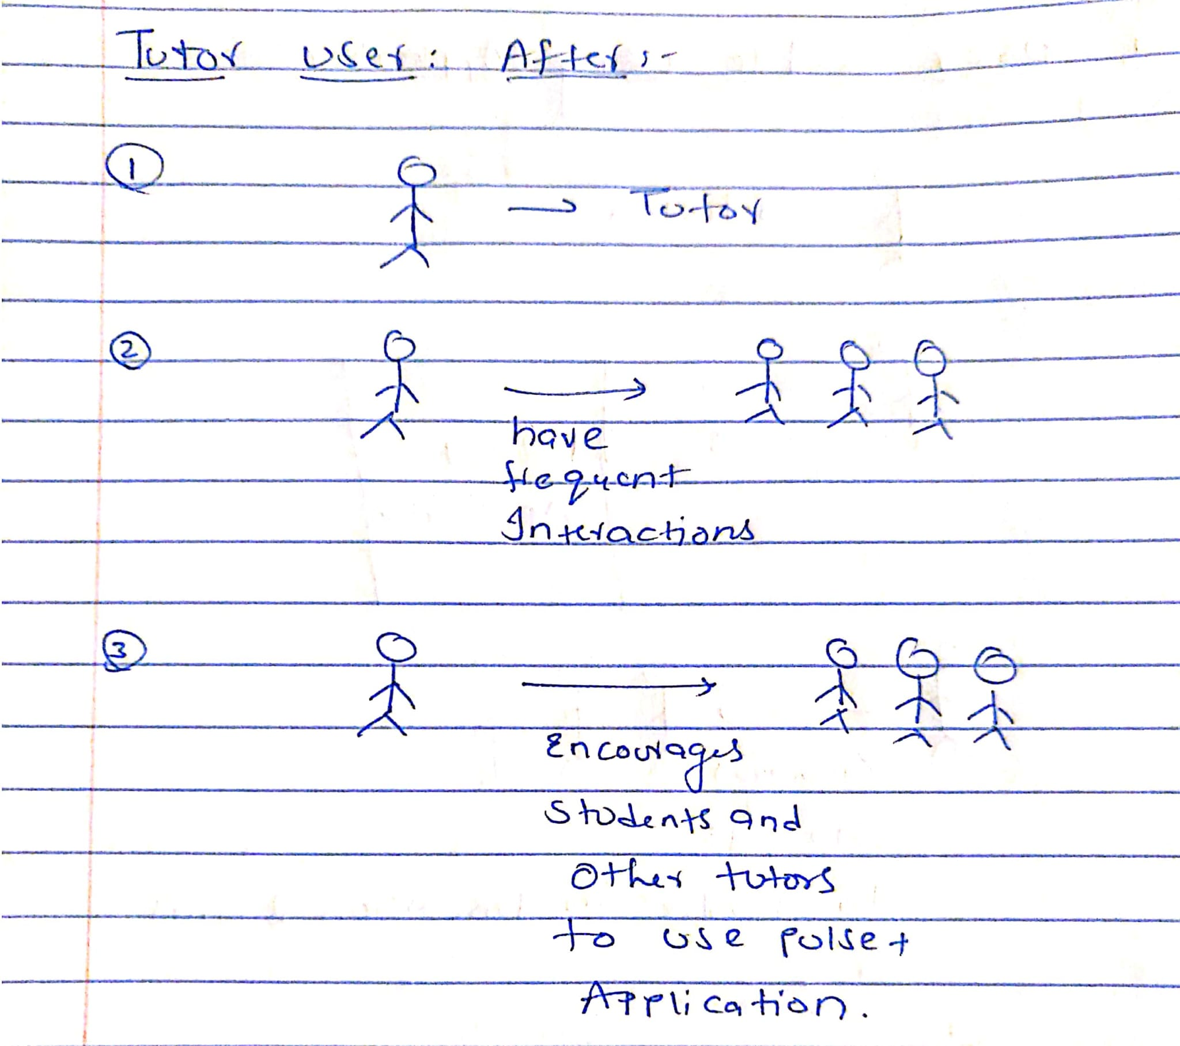
Tutor User: Sketches (After)

Slide 22
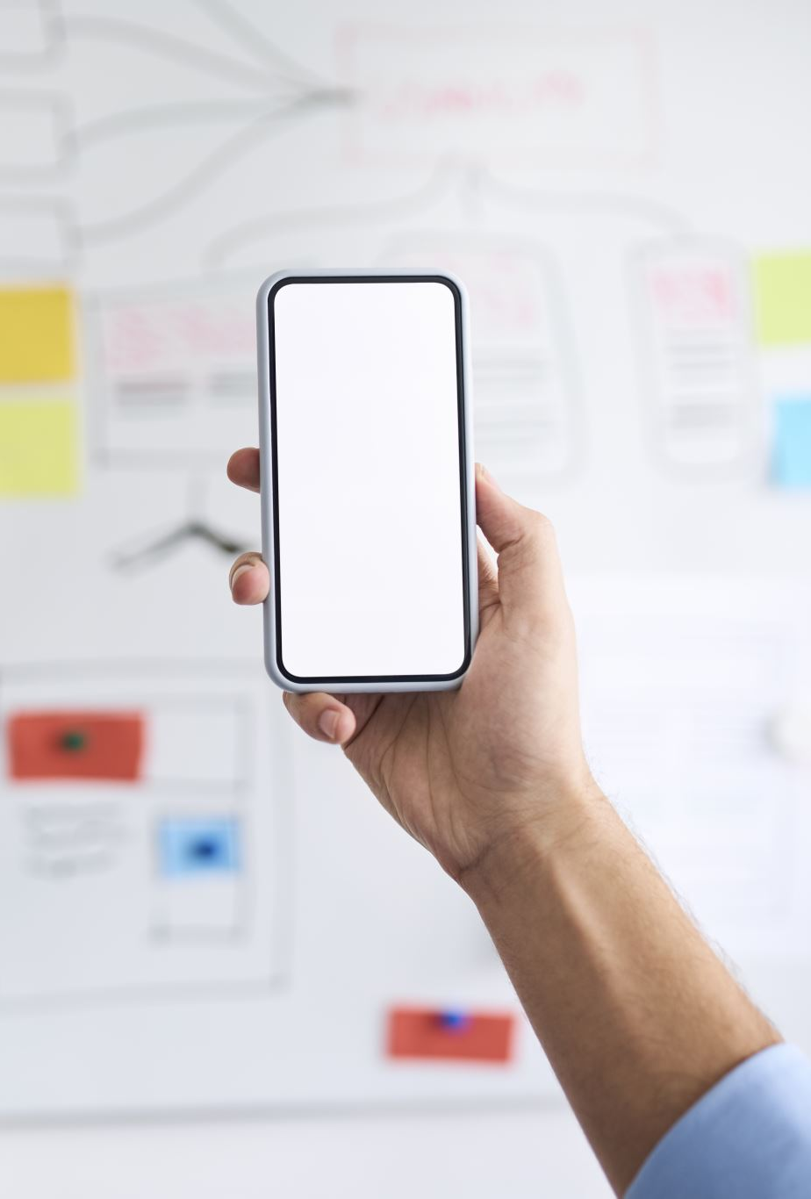
Potential problems
There might be potential app crashes due to virus from any third party software applications
Solutions :
To over come his problem, make sure that no third party applications are installed
It can also be avoided if we have a good protection apps for the mobile.
It can be avoided by using the Force stop method which will be available for the application.
It can also be avoided by keeping the application updated.
The usual fix is to clear the cache data.

Slide 23
Potential problems
There might be Data Breaches
Solutions :
To overcome this we can enable dual authentication for the Application.
We can limit access to our most valuable data
We can update the software regularly
We can enable a strong password option so , that it will be very hard to decipher.

Slide 24
Insights
Idea : Ideas will build the things, plays important role.
Affordance : Object that defines its possible users or makes clear
Users : It shows how many possible ways that, we can build an application
Scenarios/sketches : It is best way to understand application by story telling or by seeing sketches
Potential problem : By this we can say, what are the problems that users can face while using application

Slide 25
Additional Interactive Experience Ideas
Restaurant QR Application
Although there is a direct scanning of QR using Google lens to retrieve the information we can create an interaction application to include all the restaurants nearby and can add all the available items to the cart and check it out. Also the payment through credit/debit is an add-on to the Application.

Slide 26

Additional Interactive Experience Ideas
Crypto Currency Exchange
We can Create an application where currently there are some applications where the currency can be exchanged in between different users but from my application we can directly connect with the users bank account to link to the account and ask them to convert his currency and release some funds.
This is it will be more beneficial to users because the currency exchange rate is quite his when compared to that of bank’s. So it is a very good interactive Idea to implement.

Slide 27

Additional Interactive Experience Ideas
Ventra Mobile Application
This Application is for Chicago transport where it currently provides users to travel to CTA busses and trains. This application can be updated for getting favorite bus notifications and some of the busses doesn’t show the accurate time to reach the station. We can also fix that.

Slide 28

Additional Interactive Ideas
Instant File Transfer
Users Can transfer their files with the nearby users through the application where there is no limit for the size of data and there is also an additional QR Code Scanner to scan from other users we can share some music playlists as well.

Slide 29

Additional Interactive Ideas
Interactive mobile Library events
You can find events such as collecting books in exchange of submitting a book which you have already gone through. By this you gain the knowledge and you can meet so many people with similar ideas.

Slide 30


